Slide 1
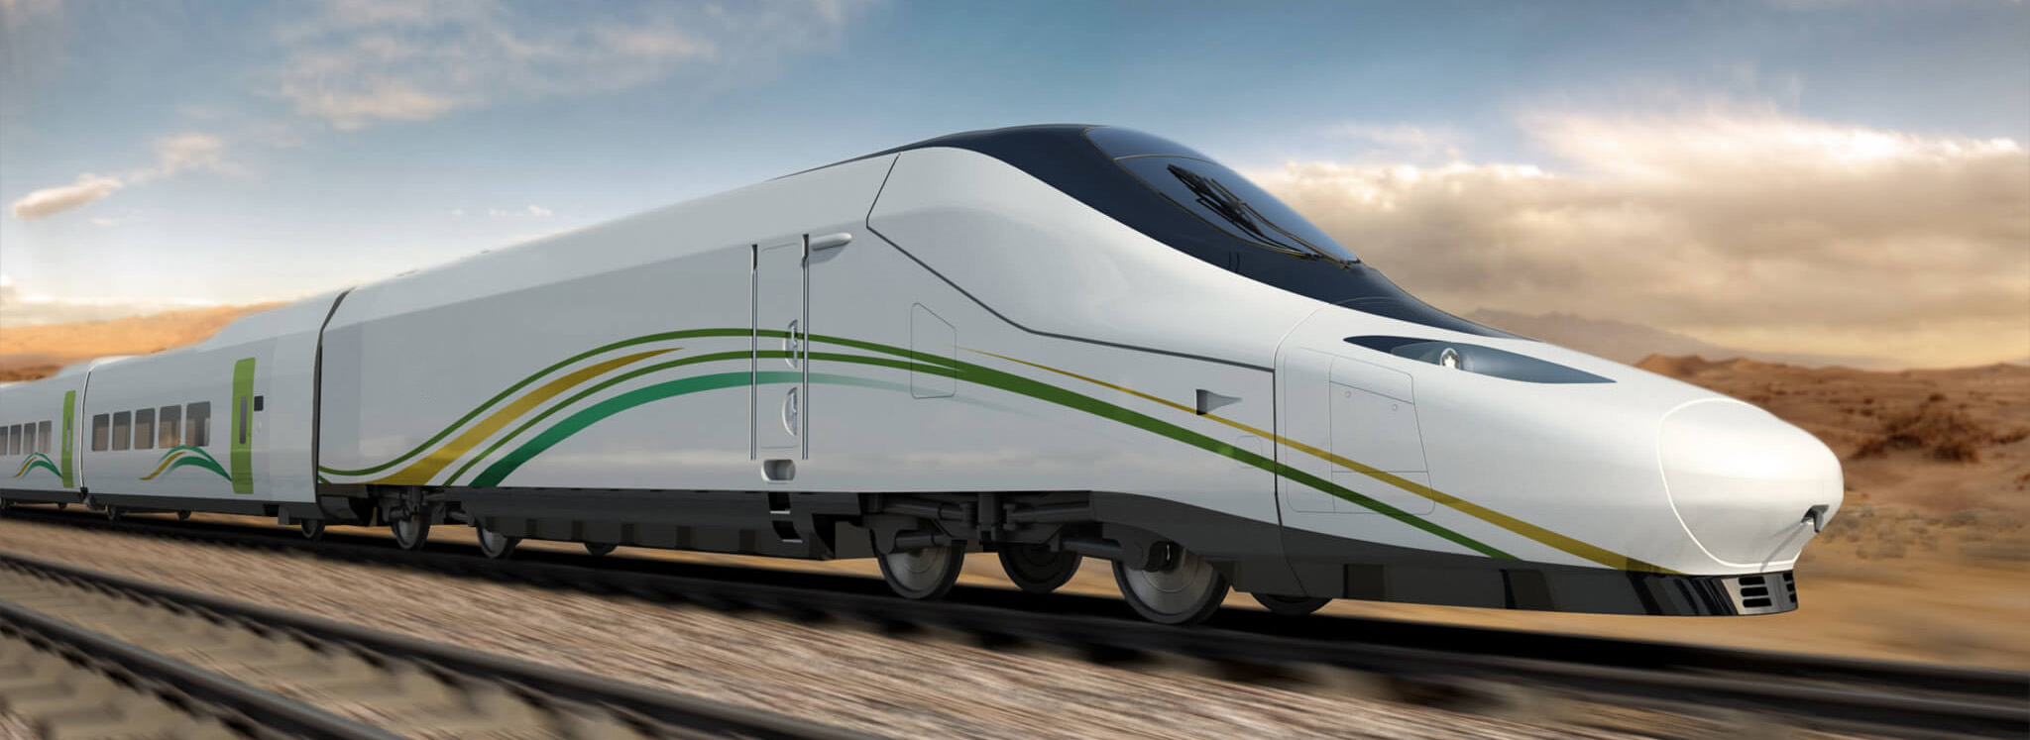
Submitted By: Nur Habibah Binti Mahbub (21201103) Maria Akter Khushi (21201107) Ritu Rani Banik (21201108) Jannatul Ferdusi (21201114) Ahsan Ullah Rakib (21201117)
Project: Railway Management System
Submitted To: Sabiha Tahsin Soha Lecturer

Slide 2
Introduction
The Railway Management System Database is a complete and effective solution created to simplify and improve the operations of railway networks. Train timetables, ticketing data, passenger records, and other elements of railway management are all stored and managed in this database, which acts as a central repository.
The Railway Management System Database facilitates smooth coordination and communication amongst many stakeholders involved in railway operations by utilizing advanced technology along with data management strategies. In addition to ensuring accurate and current information and improving overall operational efficiency, it makes the allocation of resources more effective. This database functions as a centralized location for organizing and storing a variety of railway management-related aspects, such as passenger information, train schedules, and ticketing data.

Slide 3
Entities With Their Attributes
User ( u_id(PK), u_name, password, email, phone, address)
Passenger(p_id(PK), name , age, gender, u_id(FK))
Ticket(ticket_id(PK), p_name(FK), t_id(FK), s_id(FK), class type , seat_no, s_departure , s_destination, issue date , journey date)
Special Ticket(special_id(PK), ticket_id(FK), discount, special_service)
Train status(status_id(PK), t_id(Foreign key), date , available seat, booked seat)
Train (t_id(PK), t_name , class type , s_departure , s_destination)
Time Table (time_id(PK), t_id(FK), schedule)
Station(s_id(PK), s_name , location , t_id(FK))
Payment (pay_id(PK), ticket_id (FK), amount , pay_type, pay date, pay time , u_id (FK))
Booking (book_id (PK), u_id(FK), ticket_id (FK), book_date, status, seat_no)

Slide 4
Relationship Sets
User and Passenger (1:M)
Passenger and Ticket (1:M)
Ticket and Special Ticket (1:1)
Train Status and Train (1:M)
Train and Time Table (1:M)
Train and Station (M:M)
User and Payment (1:M)
User and Booking (1:M)
Booking and Ticket (1:1)
1:1 for one-to-one relationships
1:M for one-to-many relationships
M:M for many-to-many relationships

Slide 5
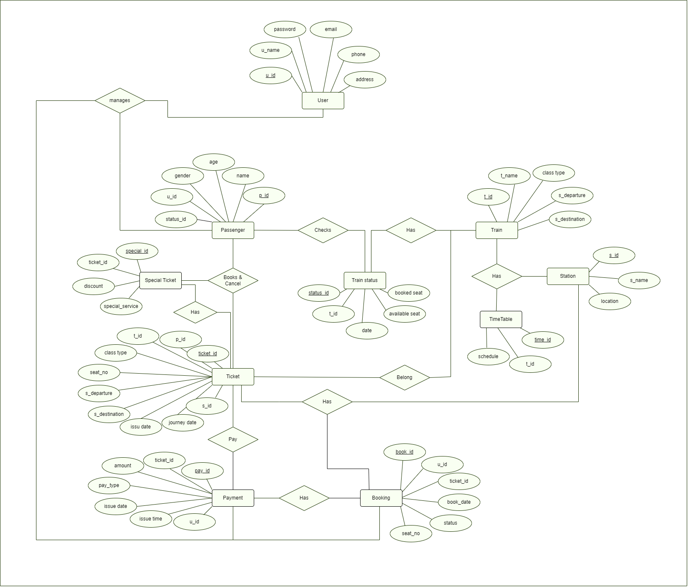
ER-Diagram

Slide 6
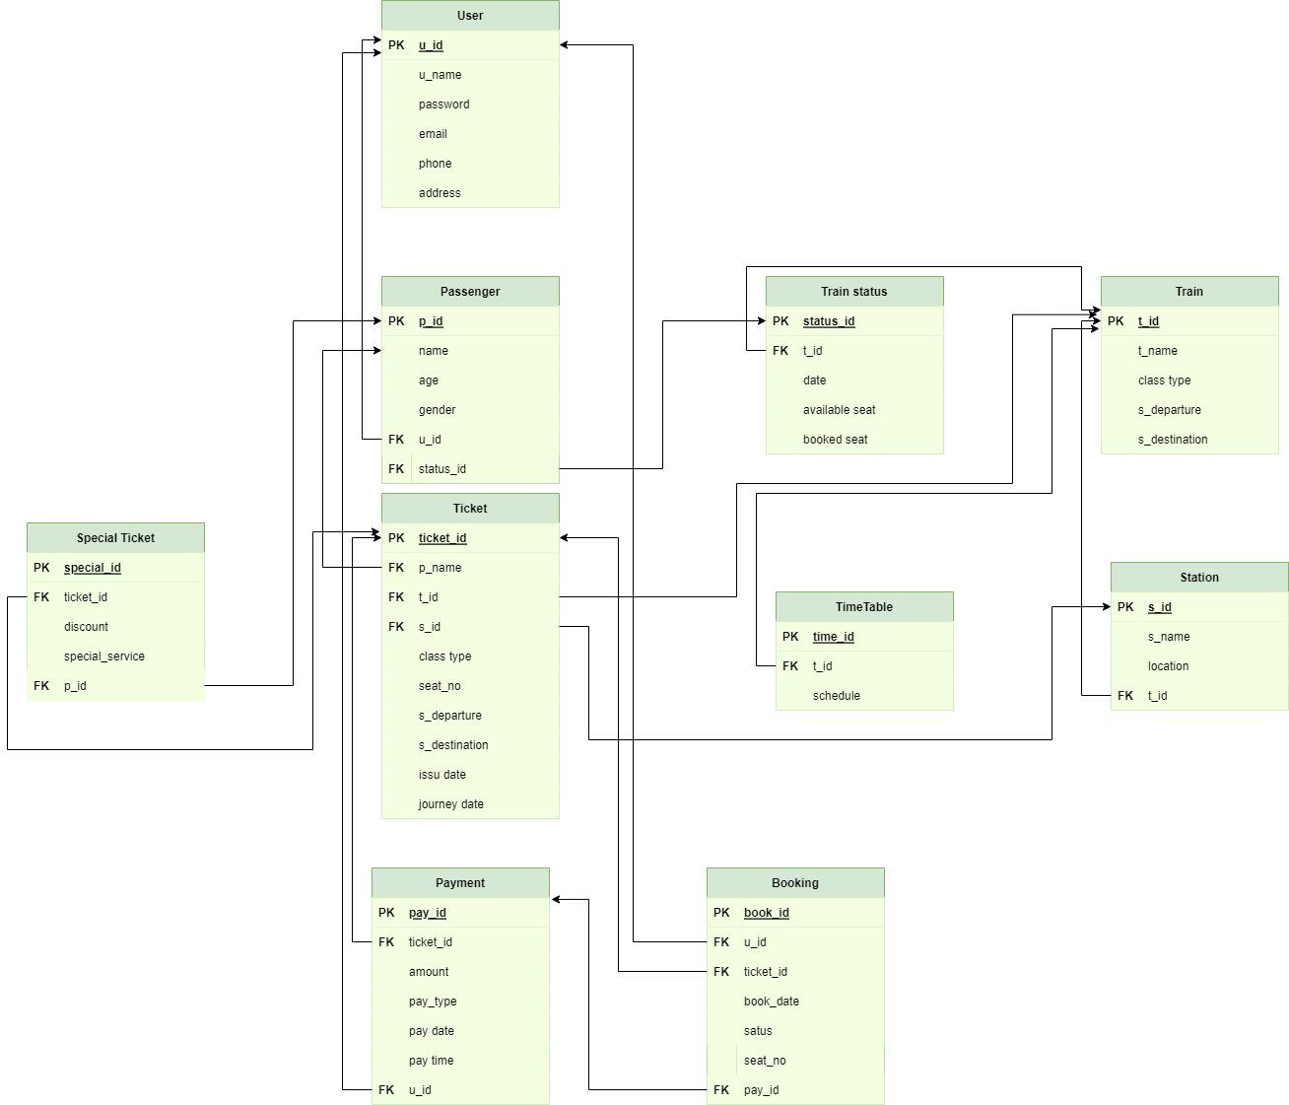
Schema Diagram

Slide 7
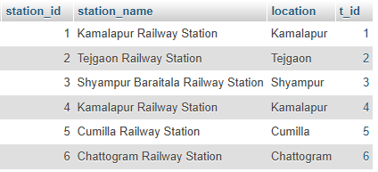
Create Table and Inserting the Values in it
Insertion:
INSERT INTO `station`(`station_id`, `station_name`, `location`, `t_id`)
VALUES ('1','Kamalapur Railway Station','Kamalapur','1');
INSERT INTO `station`(`station_id`, `station_name`, `location`, `t_id`)
VALUES ('2','Tejgaon Railway Station','Tejgaon','2');
INSERT INTO `station`(`station_id`, `station_name`, `location`, `t_id`)
VALUES ('3','Shyampur Baraitala Railway Station','Shyampur','3');
INSERT INTO `station`(`station_id`, `station_name`, `location`, `t_id`)
VALUES ('4','Kamalapur Railway Station','Kamalapur','4');
INSERT INTO `station`(`station_id`, `station_name`, `location`, `t_id`)
VALUES ('5','Cumilla Railway Station','Cumilla','5');
INSERT INTO `station`(`station_id`, `station_name`, `location`, `t_id`)
VALUES ('6','Chattogram Railway Station','Chattogram','6');
Creating the table: CREATE TABLE station (
station_id int NOT NULL PRIMARY KEY,
station_name varchar(100),
location varchar(100),
t_id int,
FOREIGN KEY (t_id) REFERENCES train(t_id)
);

Slide 8
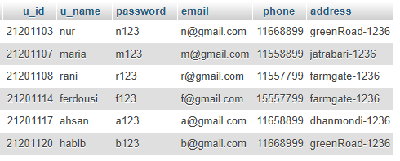
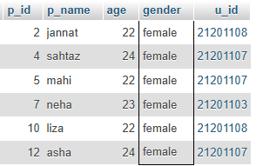
SQL Queries
1. Show the full list of users.
SELECT * FROM `users`
2. Find out the list of all female passengers in the passenger table.
SELECT `p_id`, `p_name`, `age`, `gender`, `u_id`
FROM `passenger`
WHERE gender='female'

Slide 9

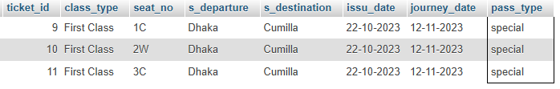
SQL Queries
3. Find the user IDs that start with 2 and ends with 7 from users table.
SELECT `u_id`, `u_name`, `password`, `email`, `phone`, `address` FROM `users`
WHERE u_id like '2______7';
4. Find the ‘special’ pass type from ticket table.
SELECT `ticket_id`, `class_type`, `seat_no`, `s_departure`, `s_destination`, `issu_date`, `journey_date`, `pass_type`
FROM `ticket`
WHERE pass_type = 'special';

Slide 10
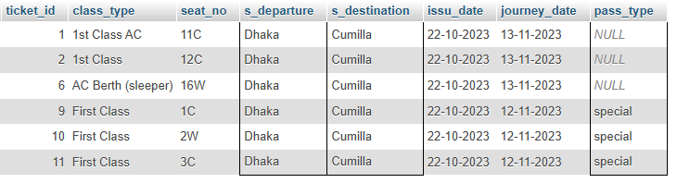

SQL Queries
5. Find out the list of ticket_id where the train departs from Dhaka to the destination Cumilla from ticket table.
SELECT `ticket_id`, `class_type`, `seat_no`, `s_departure`, `s_destination`, `issu_date`, `journey_date`, `pass_type`
FROM `ticket`
WHERE s_departure = 'Dhaka' and s_destination = 'Cumilla';
6. Show the train status of train ID “2”.
SELECT `t_name`, train_status.available_seat, `class_type`, `s_departure`, `s_destination`
FROM `train`,train_status
WHERE train.t_id = train_status.t_id and train.t_id=2 ;

Slide 11
CEP Mapping
How Knowledge Profile (K’s) are addressed through our project and mapping among K’s, COs, POs:
K’s | Attribute | How K’s are addressed through our project | CO | PO
K3 | Engineering fundamentals | Our project need understanding on Database fundamental to formulate a suitable model. |  | PO1
K4 | Specialist knowledge | Railway service related knowledge. |  | PO1
K5 | Engineering design | We used ER diagram and Schema diagram to design our project. | CO3, CO4 | PO3, PO5
K6 | Engineering practice | Implemented our project in XAMPP Server Management Studio with the help of SQL language. | CO1, CO2, CO5 | PO5
K7 | Comprehension | Our project gives positive feedback on society as it will help people to get railway services easily and effectively. | CO6, CO7 | PO6, PO7, PO8

Slide 12
CEP Mapping
How Complex Engineering Problems (P’s) are addressed through our project and mapping among P’s, COs, POs:
P’s | Attribute | How P’s are addressed through our project | CO | PO
P1 | Depth of knowledge required | Creating a database project for the railway sector involves designing a database system to manage various aspects of railway operations, including passenger information, train schedules, ticketing, maintenance, and many more. | CO 1-5 | PO1, PO3, PO 5-8
P3 | Depth of analysis required | Analysis the railway sector in a database involves examining various aspects of the industry, such as operations, infrastructure, financials, safety, and performance. To perform a deep analysis, you would typically require a comprehensive database with relevant data. Below are some key areas to consider when conducting a thorough analysis of the railway sector. | CO3, CO4, CO5 | PO 6-8, PO12
P7 | Interdependence | The interdependence of various aspects within the railway sector is an important part of understanding its operations and challenges. Interdependence in this context refers to how different elements within the railway system rely on each other and how changes in one area can affect others. | CO8 | P10, P11

Slide 13
CEP Mapping
How Complex Engineering Activities (A’s) are addressed through our project and mapping among A’s, COs, POs:
A’s | Attribute | How A’s are addressed through our project | CO | PO
A1 | Range of resources | Resources in the railway sector are diverse and encompass various categories to support the efficient operation, maintenance, and development of rail infrastructure and services. They are rolling stocke, ,technology & equipment | CO8 | P11
A4 | Consequences for society and the environment | The railway sector has both positive and negative consequences for society and the environment. | CO6 | P6, P7

Slide 14
Thank You
Everyone

